Slide 1

The Kishon River Ecosystem Analysis
Osher Ben Zazon (212240238)
Andy Lewis Sapner (213298524)

Slide 2
Table of contents
01
02
03
04
05
Introduction
Overview of Existing Work
Methods and Findings
Discussion
System Live Presentation

Slide 3
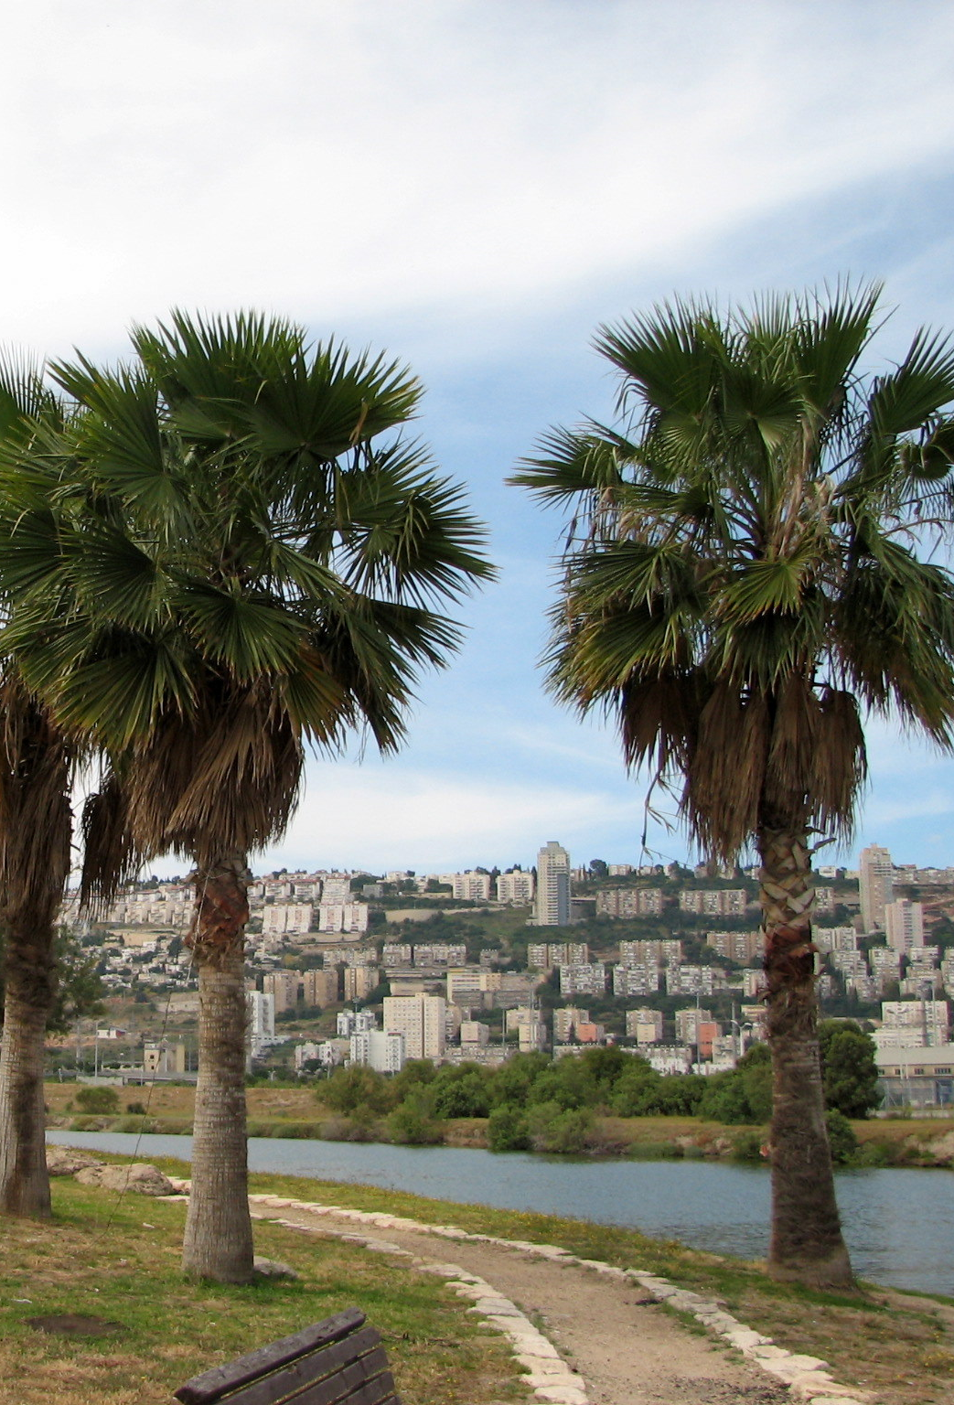
01
Introduction

Slide 4
Introduction about the Kishon RIver
Kishon RIver
Research Question
The second largest coastal river In Israel.
Highly polluted due to its long history of contamination.
What are the relations between specific measurements of the river and the total amount of animal and plant observations there?

Slide 5

02
Overview of Existing Work

Slide 6
Overview of Existing Work
Importance of Nitrogen to Israeli Coastal Shelf
Nutrient-Related Pollution
Fall and Rise of the Kishon River
Nitrogen dynamics along the Israeli coastline are dominated by oceanic currents, with minimal ecosystem impact despite significant inputs.
Twenty years of monitoring show the Kishon estuary's water quality remains poor, requiring a combined chemical and biological assessment due to limited flushing.
The Kishon River's severe 1950s pollution, initially neglected for national development, began remediation in the 1990s due to technological advances, stronger laws, and a public health scandal.

Slide 7
Overview of Existing Work (Cont.)
Assessment of the Kishon River
Pollution Levels Along the Kishon RIver
In 2002, Greenpeace opposed Israel's plan to dump industrial waste into Haifa Bay, arguing it would harm marine life and that true solutions required stricter regulations and source control.
Researchers studying the Kishon River sediments (1992–1993) identified heavy pollution near industrial zones, confirming contamination by heavy metals and organic waste through comprehensive sampling and analysis.

Slide 8
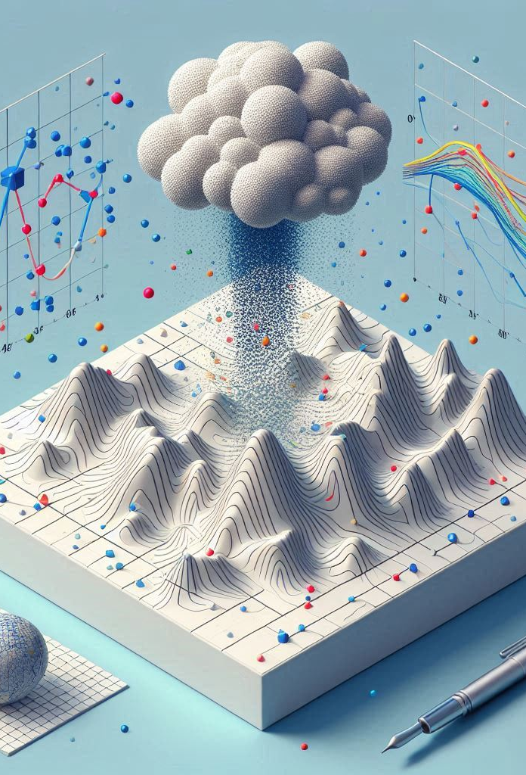
03
Methods and Findings

Slide 9
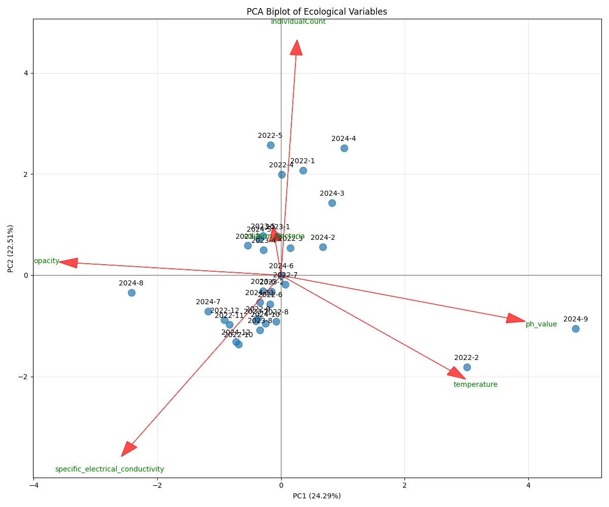
PCA
Principal component analysis (PCA) is a multivariate technique that analyses a data table in which observations are described by several inter-correlated quantitative dependent variables.
Its goal is to extract the valuable information from the table.

Slide 10
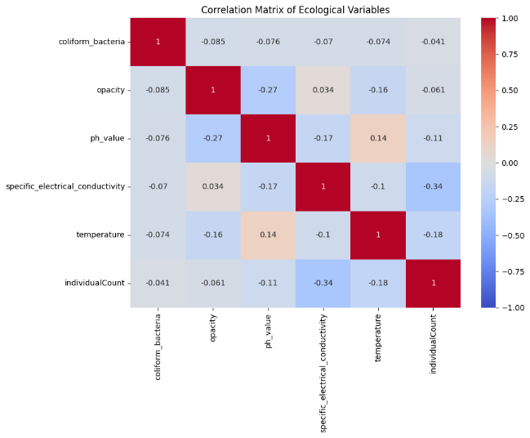
PCA (Cont.)
When using PCA, a correlation matrix is created. It shows the relationships between variables in the analysis.
 | Individuals Count | Coliform Bacteria | Opacity | Specific Electrical Conductivity
Individuals Count | - | Negative | Negative | Negative
Coliform Bacteria | Negative | - | Negative | Negative
Opacity | Negative | Negative | - | Positive
Specific Electrical Conductivity | Negative | Negative | Positive | -

Slide 11
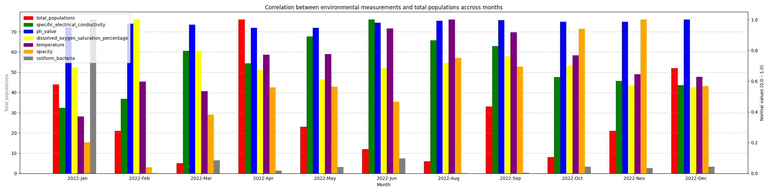
Correlations
Morad Reservoir Kfar Baruch Station, 2022

Slide 12
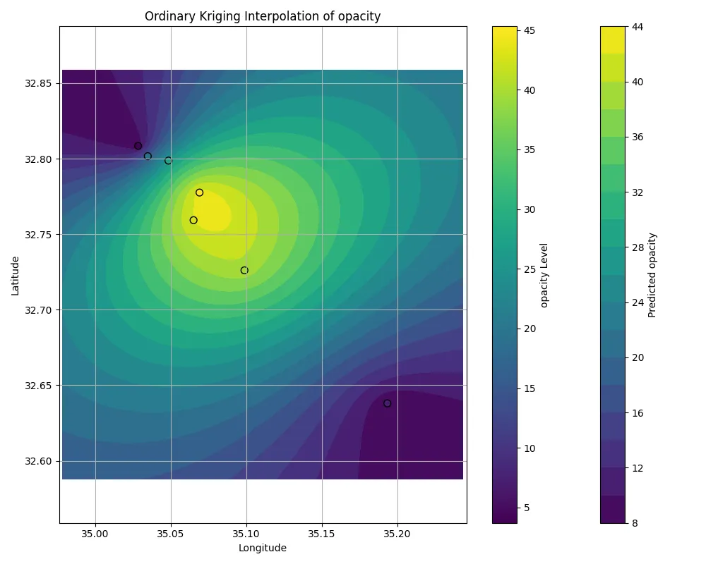
Kriging
It serves to estimate a value at a point of a region for which a variogram is known, using data in the neighbourhood of the estimation location.
February 2022

Slide 13
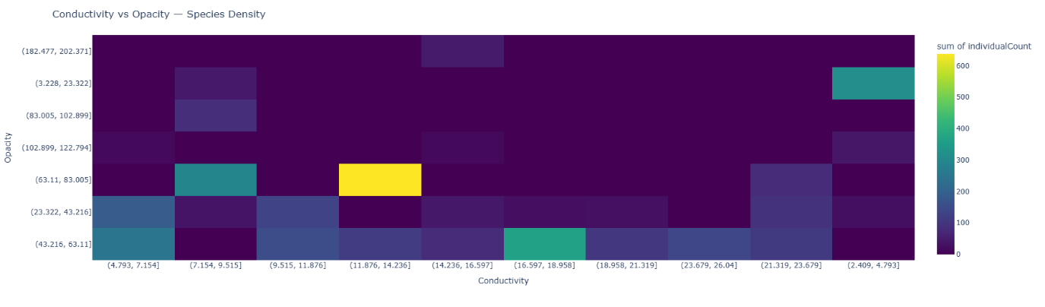
Relationships

Slide 14
Relationships (Cont.)
Conductivity Ranges | Opacity Ranges | Coliform Bacteria Ranges | Individuals Count
(11.88, 14.24] | (63.11, 83.01] | (17.2, 93835.48] | 638
(16.6, 18.96] | (43.22, 63.11] | (17.2, 93835.48] | 363
(2.41, 4.79] | (3.23, 23.32] | (17.2, 93835.48] | 314
(7.15, 9.52] | (63.11, 83.01] | (17.2, 93835.48] | 292
(4.79, 7.15] | (43.22, 63.11] | (281472.037, 375290.32] | 250
(4.79, 7.15] | (23.32, 43.22] | (17.2, 93835.48] | 188
(9.52, 11.88] | (43.22, 63.11] | (17.2, 93835.48] | 151
(23.68, 26.04] | (43.22, 63.11] | (17.2, 93835.48] | 137
(9.52, 11.88] | (23.32, 43.22] | (17.2, 93835.48] | 129
(11.88, 14.24] | (43.22, 63.11] | (17.2, 93835.48] | 114
(18.96, 21.32] | (43.22, 63.11] | (17.2, 93835.48] | 105
(7.15, 9.52] | (83.01, 102.9] | (93835.477, 187653.76] | 83
(14.24, 16.6] | (43.22, 63.11] | (17.2, 93835.48] | 80
(21.32, 23.68] | (63.11, 83.01] | (17.2, 93835.48] | 79
(21.32, 23.68] | (23.32, 43.22] | (17.2, 93835.48] | 51
(14.24, 16.6] | (182.48, 202.37] | (17.2, 93835.48] | 48
(7.15, 9.52] | (3.23, 23.322] | (17.2, 93835.48] | 43
(14.24, 16.6] | (23.32, 43.22] | (844381.72, 938200] | 42
(2.41, 4.79] | (102.9, 122.79] | (93835.477, 187653.76] | 38
(7.15, 9.52] | (23.32, 43.22] | (17.2, 93835.48] | 35
(18.96, 21.32] | (23.32, 43.22] | (93835.477, 187653.76] | 27
(2.41, 4.79] | (23.32, 43.22] | (17.2, 93835.48] | 25
(21.32, 23.68] | (43.22, 63.11] | (17.2, 93835.48] | 25
(16.6, 18.96] | (23.32, 43.22] | (17.2, 93835.48] | 24
(14.24, 16.6] | (102.9, 122.79] | (17.2, 93835.48] | 15

Slide 15
Relationships (Cont.)
Conductivity Ranges | Individuals Count | Individuals Count Percentage
(2.41, 4.79] | 377 | 10.97%
(4.79, 7.15] | 452 | 13.15%
(7.15, 9.52] | 453 | 13.18%
(9.52, 11.88] | 280 | 8.15%
(11.88, 14.24] | 752 | 21.88%
(14.24, 16.6] | 185 | 5.38%
(16.6, 18.96] | 387 | 11.26%
(18.96, 21.32] | 132 | 3.84%
(21.32, 23.68] | 282 | 8.2%
(23.68, 26.04] | 137 | 3.99%
Opacity Ranges | Individuals Count | Individuals Count Percentage
(3.23, 23.32] | 357 | 10.39%
(23.32, 43.22] | 563 | 16.38%
(43.22, 63.11] | 1310 | 38.11%
(63.11, 83.01] | 1009 | 29.36%
(83.01, 102.9] | 83 | 2.41%
(102.9, 122.79] | 67 | 1.95%
(122.79, 142.69] | 0 | 0%
(142.69, 162.58] | 0 | 0%
(162.58, 182.48] | 0 | 0%
(182.48, 202.37] | 48 | 1.4%

Slide 16
Relationships (Cont.)
Coliform Bacteria Ranges | Individuals Count | Individuals Count Percentage
(17.2, 93835.48] | 2856 | 86.65%
(93835.48, 187653.76] | 148 | 4.49%
(187653.76, 281472.04] | 0 | 0%
(281472.04, 375290.32] | 250 | 7.58%
(375290.32, 469108.6] | 0 | 0%
(469108.6, 562926.88] | 0 | 0%
(562926.88, 656745.16] | 0 | 0%
(656745.16, 750563.44] | 0 | 0%
(750563.44, 844381.72] | 0 | 0%
(844381.72, 938200] | 42 | 1.27%

Slide 17

04
Discussion

Slide 18
Discussion
Research Question
PCA
Relationships between measures of the river and the total amount of observations found in the river.
From this method, we understood that we need to select only a few of the measures - specific electrical conductivity, opacity, coliform bacteria, and individuals.
Kriging
Conclusion
There are certain locations in the river where measures can be higher, so it led us to research more on what happens when the levels of measurements are either low or high.
Using correlations, we concluded that at lower levels of all measures, the number of individuals was higher.

Slide 19
Conclusion and Future Work
Conclusion
Future Work
Defined relationships between river measurements and populations.
Maintain measures in lower values, to increase populations.
Check more relationships between measures.
Redo the research with more data when available.

Slide 20
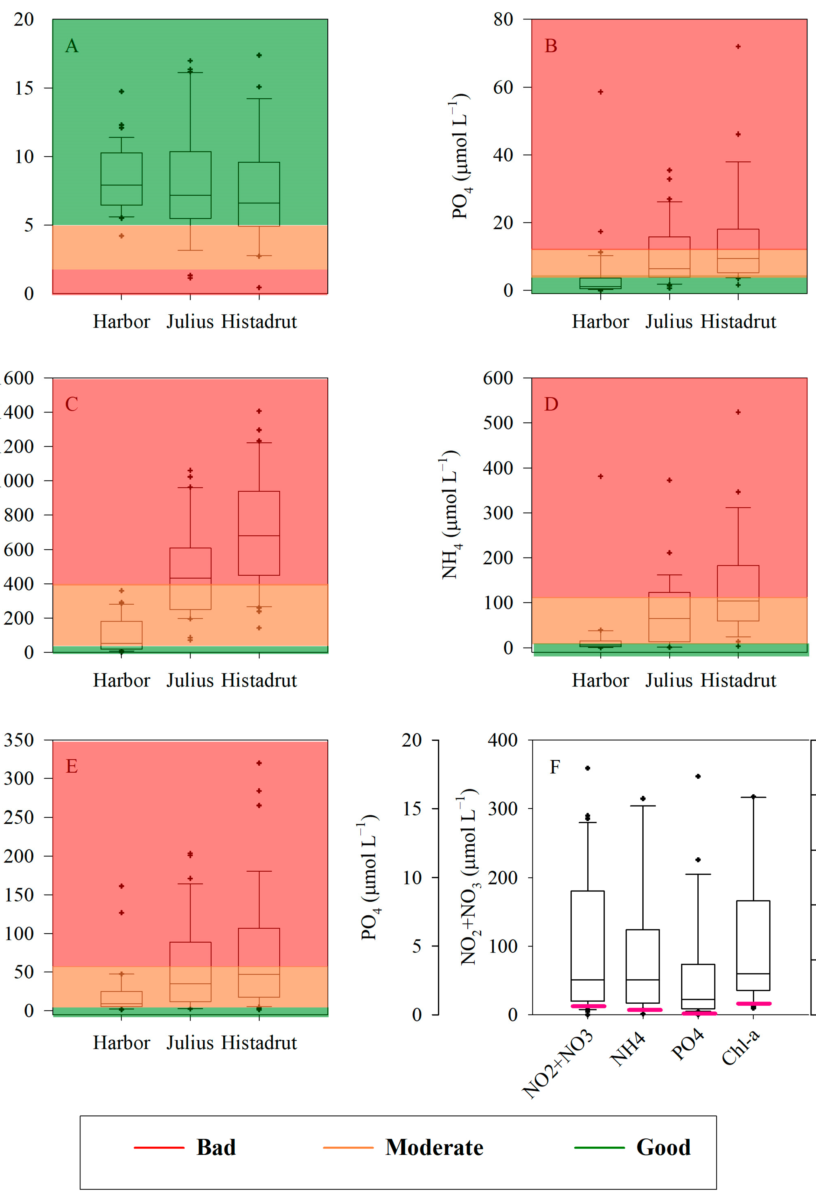
05
System Live Presentation

Slide 21
Thanks!

